Slide 1

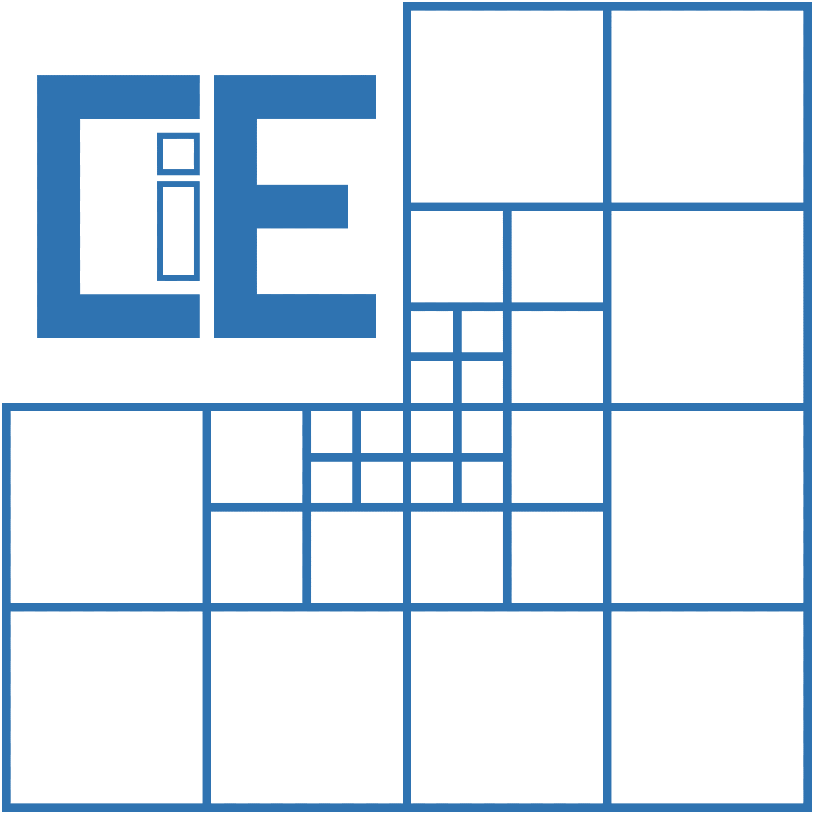

An Application to Optimize Lap-times for Race Cars
Group Members:
Alaa Bashir | ge73cec
Ankit Khot | ge73xuq
Máté Kelemen | ge49pil
Supervised by: Jan Janse van Rensburg and Steve Schäfer

Slide 2

Outline:
Recap
Introduction to point mass model
Literature Review for vehicle dynamics
Point mass dynamics
Controller Design
Summary

Slide 3
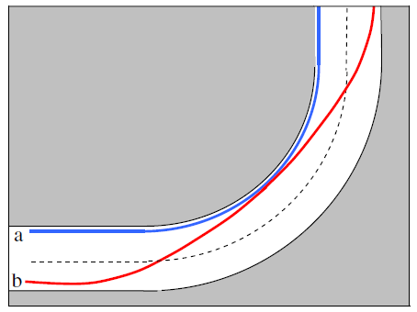
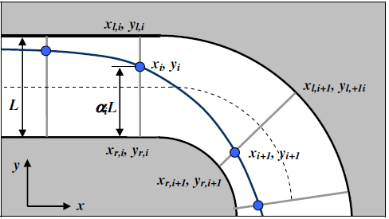
Recap
Goal :
To minimize total lap time
Problem Statement :
Dual problem
So far :
Geometric Optimization
Interface to 3D Engine(UNREAL+Simulink)
A Question from last session :
Order of Optimization (fmincon MATLAB function)

Slide 4
Milestones
Familiarize ourselves with MATLAB and Simulink
Literature Review
(Optimizing the path)
Literature Review
(Vehicle dynamics constraints)
Start
Controller controlled Vehicle in Unreal engine
Finding Optimum path for a point mass
Finding Optimum lap time for a point mass

Slide 5
Milestones
Extending point mass model for single track and double track models
Generalizing the model for different race tracks

Slide 6
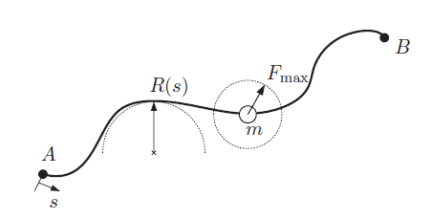
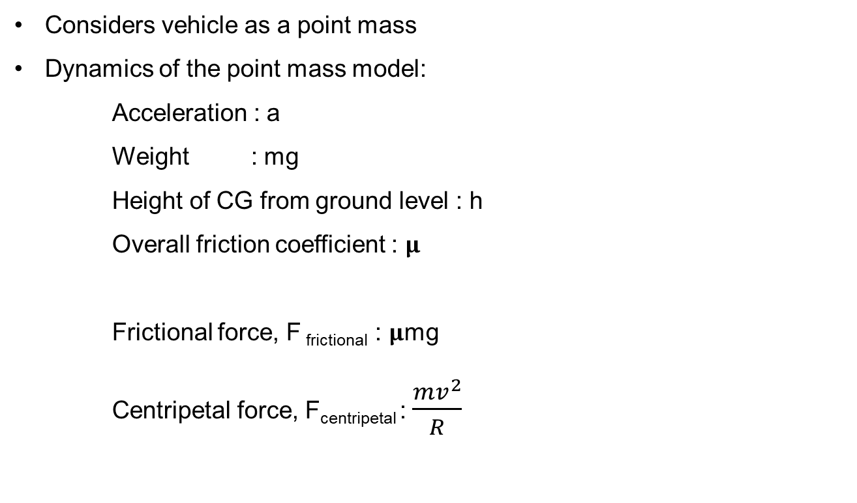
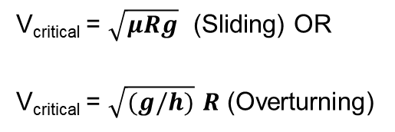
Introduction : Point Mass Model
Considers vehicle as a point mass
Dynamics of the point mass model:
Acceleration : a
Weight : mg
Height of CG from ground level : h
Overall friction coefficient : 𝛍
Frictional force, F _{frictional} : 𝛍mg
Centripetal force, F_{centripetal} : $\frac{mv^{2}}{R}$
V_{critical} = $\sqrt{μRg}$ (Sliding) OR
V_{critical} = $\sqrt{(g/h)}$ $R$ (Overturning)
Notes:
Point mass models
Double dots

Slide 7
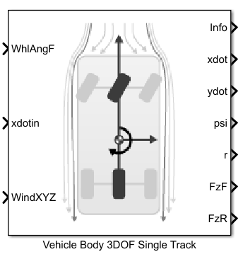
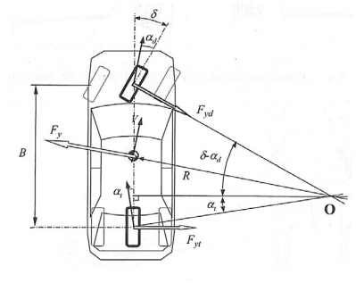
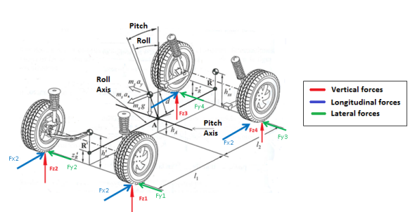
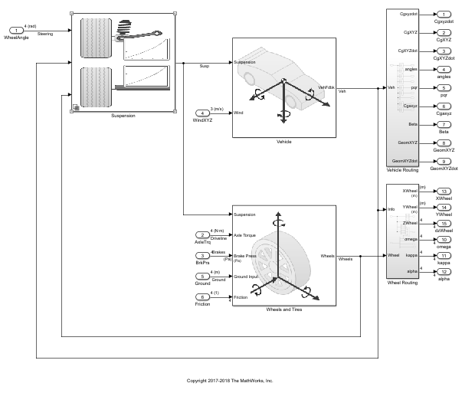
Vehicle Dynamics : Literature Review
Vehicle Models :
Single Track Model :
3 DOFs : Longitudinal, Lateral and Yaw
Does not consider the rolling effect
Double Track Model :
6DOFs : Longitudinal, Lateral, Vertical
Yaw, Roll, Pitch
These models involve modelling of
the Tire, Suspension system, Chassis,
Transmission system etc.
Simulink : Reuse of the Simulink Vehicle Dynamics Block set.
Image source : Automotive engineering, systems and dynamic behavior by Pablo Luque.
Notes:
Expand on Simulink – reuse Simulink libraries (vehicle dynamics blockset)
+ slide for Simulink model screenshots – check documentation

Slide 8
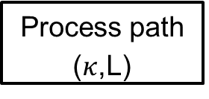
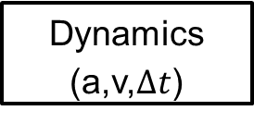
MATLAB Implementation (PM dynamics)
Select optimization target
Define dynamics
Optimization
Process path ($κ$,L)
Preconstraining
Dynamics (a,v,$Δt$)
Notes:
Optimization( geometric(total length, curvature), lap time )
-> if lap time, we need the dynamics (infinite acceleration, rate limited acceleration, RL+brake checking )
Process track -> get curvatures, length, … (geometric properties of the path)
Preconstraining (calculate max velocities for every point, apply brake checking )
Dynamics -> calculate accelerations,velocities -> total lap time
Optimization algorithm gives us a new path

Slide 9
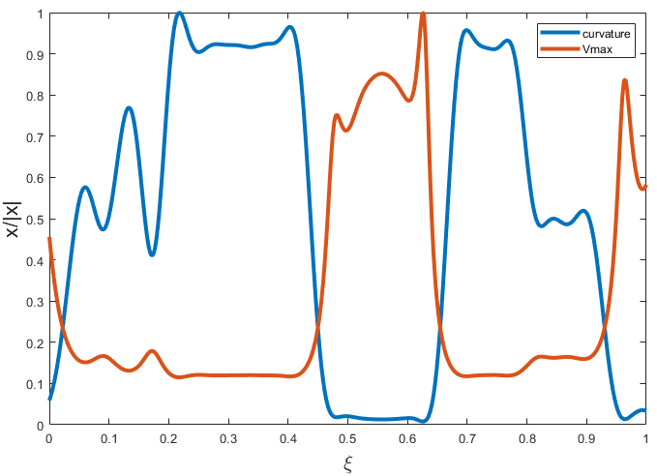

Point Mass Dynamics
Dynamics
Infinite acceleration
$$v\left(t_{i}\right)=v_{max}(κ(t_{i}))$$
Notes:
Point mass models
Double dots

Slide 10
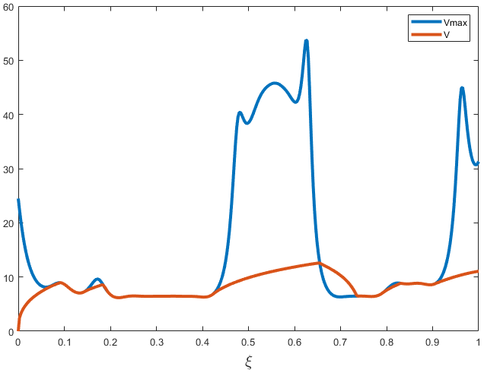

Point Mass Dynamics
Dynamics
Rate limited acceleration
$$v_{i+1} =v_{i}+Δv_{i}$$
$$Δv_{i+1}=f(v_{i},v_{i}^{max},Δs_{i})$$
Notes:
Point mass models
Double dots

Slide 11
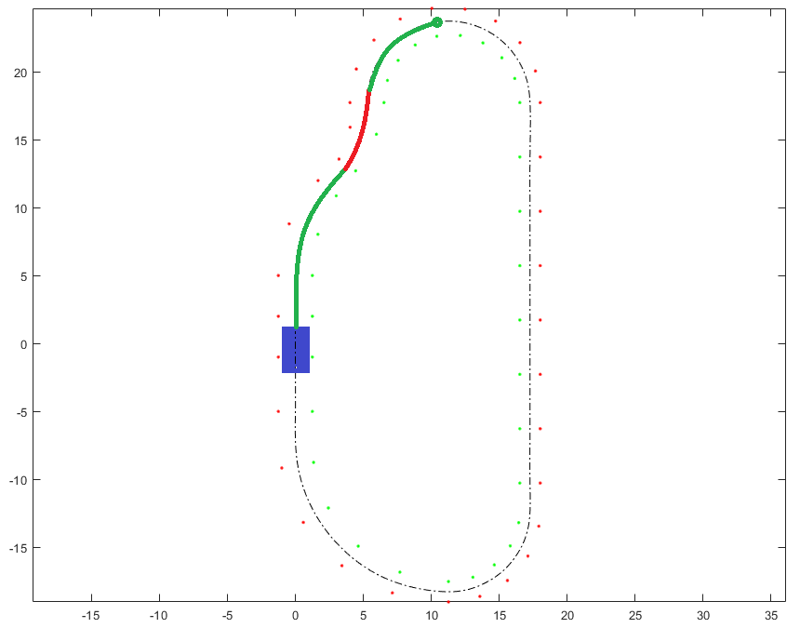
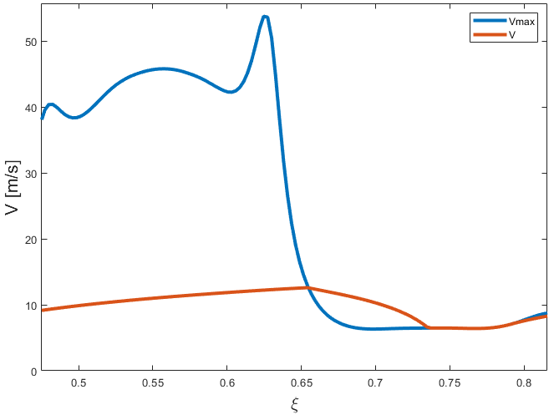
Point Mass Dynamics
Dynamics
Rate limited acceleration with break checking
Notes:
Point mass models
Double dots

Slide 12
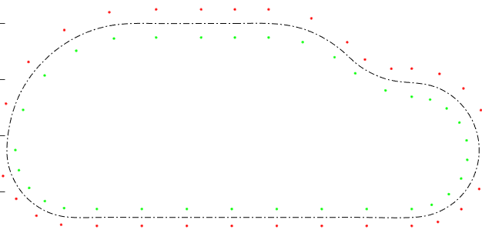
Point Mass Dynamics
Lap times [s] |  | Optimization target
 |  | Length | Curvature | Time
Model | Infinite accel. | 15.08 | 16.54 | 13.66
 | Rate limited* | 15.76 | 16.85 | 13.14
* Starts with maximum velocity
Notes:
Change to a full track
More details and parameters + which model we’re using
Time/average speed, 3 results for different paths
Initial velocity for the rate limited model

Slide 13
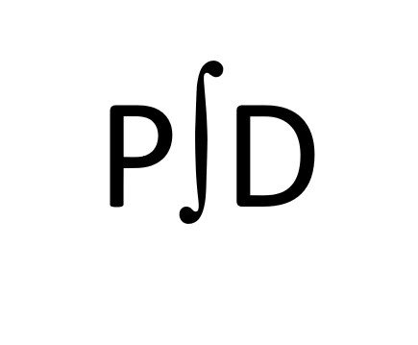
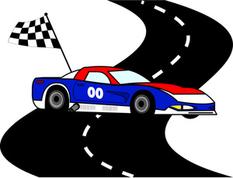
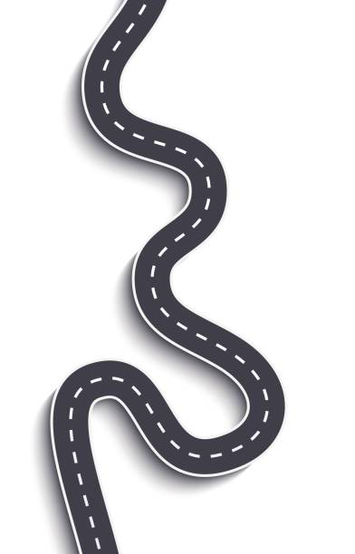
Controller Design Roadmap
Test case creation
Build a control system
Testing and Visualization

Slide 14
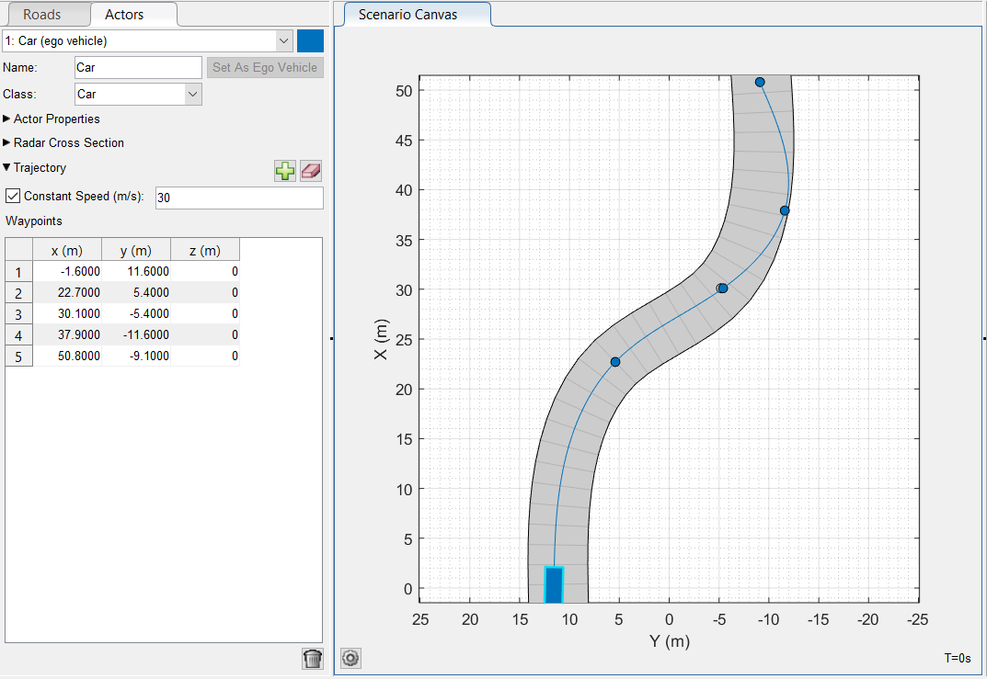
Test Case Creation
Using “Driving Scenario Designer” App to get:
Reference position
Road curvature
Speed Profile
Direction

Slide 15
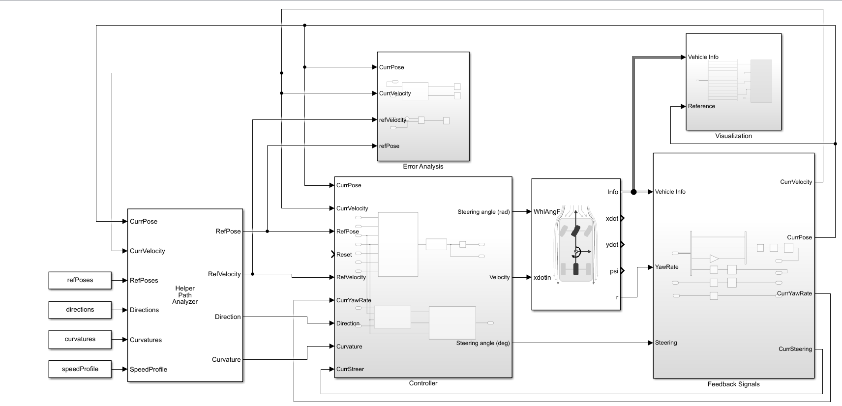
Control System

Slide 16
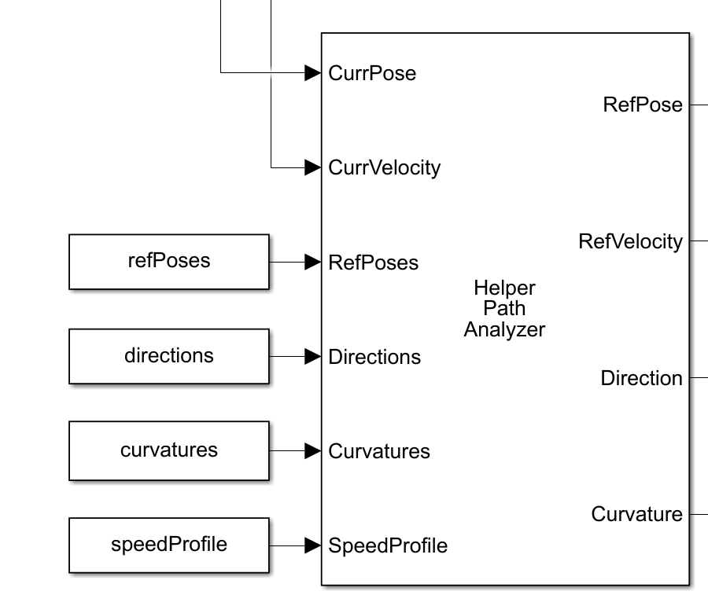
Control System
Output of the Driving Scenario Design

Slide 17
Control System

Slide 18
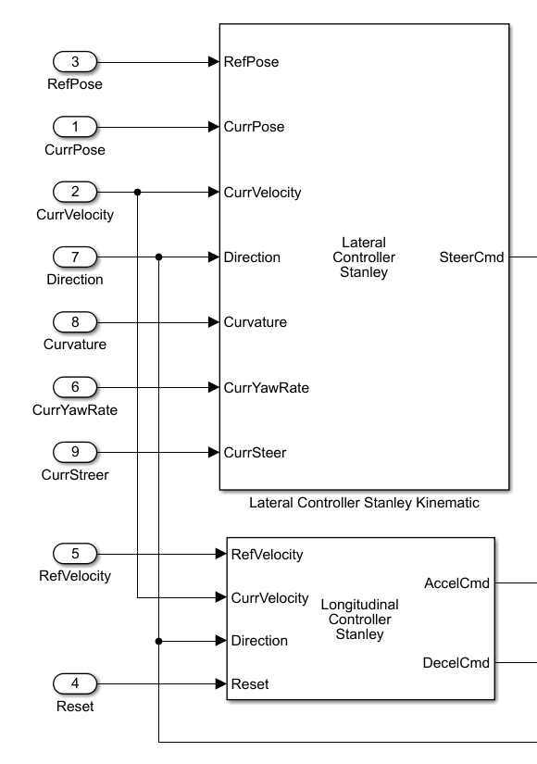
Control System
Lateral Controller
Longitudinal Controller

Slide 19
Control System

Slide 20
Control System

Slide 21
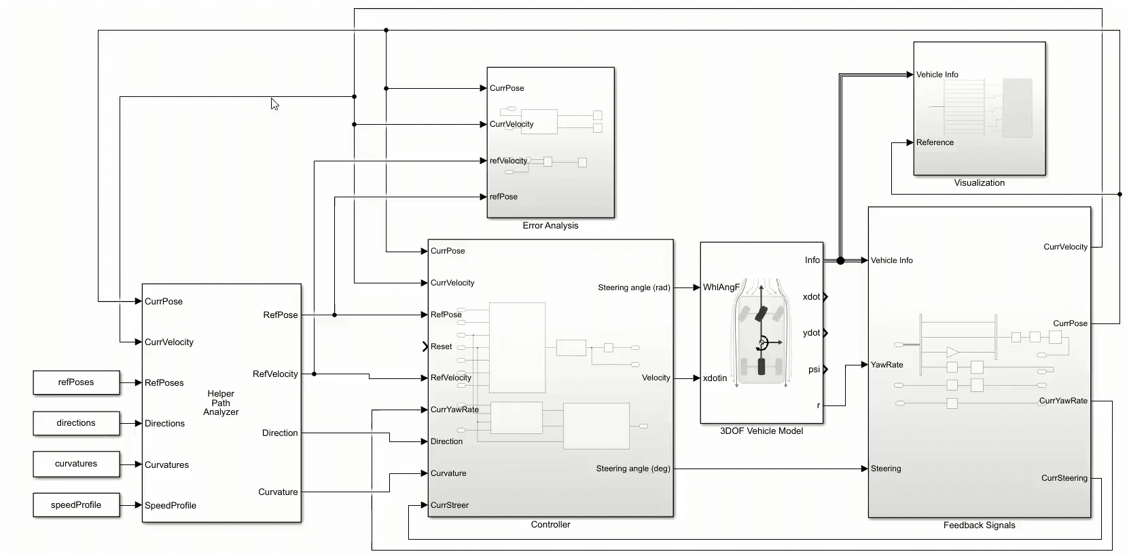
Testing and Visualization
Using Vehicle XY Plotter

Slide 22
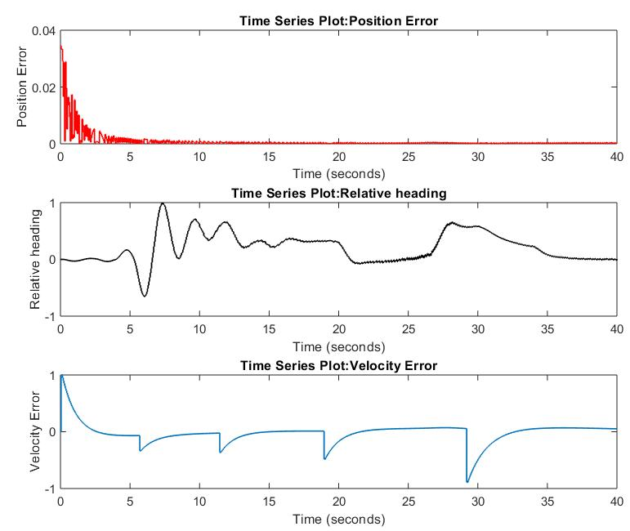
Controller Evaluation
Position Error
Relative Heading
Velocity Error

Slide 23

Summary
Recap
Literature Review for vehicle dynamics
MATLAB Implementation
Controller Design in Simulink

Slide 24
References :
A Vehicle Dynamics Model for Driving Simulators - Jorge Gómez Fernández
An overview on vehicle dynamics - Shaopu Yang, Yongjie Lu, Shaohua Li

Slide 25
